Slide 1
Microsoft MOVIE ANALYSIS

Slide 2
introduction
Microsoft has seen all the big companies creating original video content and they want to get in on the fun. They have decided to create a new movie studio, but they don’t know anything about creating movies. You are charged with exploring what types of films are currently doing the best at the box office. You must then translate those findings into actionable insights that the head of Microsoft's new movie studio can use to help decide what type of films to create.

Slide 3
OBJECTIVE
The main purpose of this project is to analyze data in order to derive insights on the best rated movies and movie genres. With this, Microsoft team can use these insights to make informed decisions on what movie types to venture into.
Exploratory data analysis is expected in order to understand the nature of the data

Slide 4
About the data
Three datasets were provided namely;
imdb.title.basics.csv, imdb.title.crew.csv and bom.movie_gross.csv
The datasets represent information about various movies, their genres and how they were rated by their audience as well as movie raters. The last dataset also provides the revenue made from each movie.
The data was thus merged in order to perform multivariate data analysis, using pd.merge for common columns
The data availed was from IDMB

Slide 5
Descriptive analysis of the columns
 | start_year | averagerating | numvotes | domestic_gross | foreign_gross | year
count | 3027.000000 | 3027.000000 | 3.027000e+03 | 3027.000000 | 3027.000000 | 3027.000000
mean | 2013.783284 | 6.457582 | 6.170030e+04 | 1513.000000 | 1513.000000 | 2014.077635
std | 2.466955 | 1.012277 | 1.255132e+05 | 873.963958 | 873.963958 | 2.442245
min | 2010.000000 | 1.600000 | 5.000000e+00 | 0.000000 | 0.000000 | 2010.000000
25% | 2012.000000 | 5.900000 | 2.117000e+03 | 756.500000 | 756.500000 | 2012.000000
50% | 2014.000000 | 6.600000 | 1.310900e+04 | 1513.000000 | 1513.000000 | 2014.000000
75% | 2016.000000 | 7.100000 | 6.276550e+04 | 2269.500000 | 2269.500000 | 2016.000000
max | 2019.000000 | 9.200000 | 1.841066e+06 | 3026.000000 | 3026.000000 | 2018.000000

Slide 6
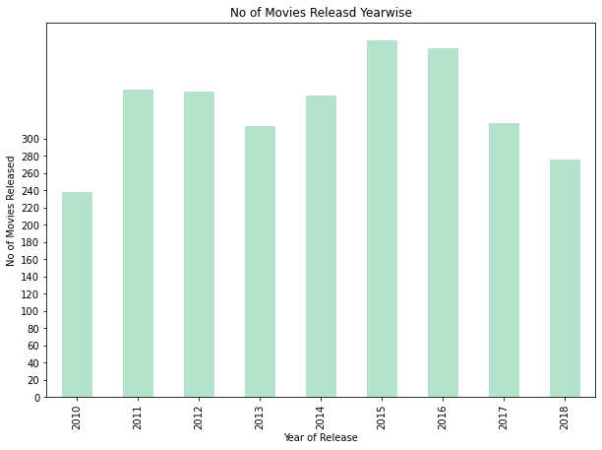
Distribution of movies by year of release

Slide 7
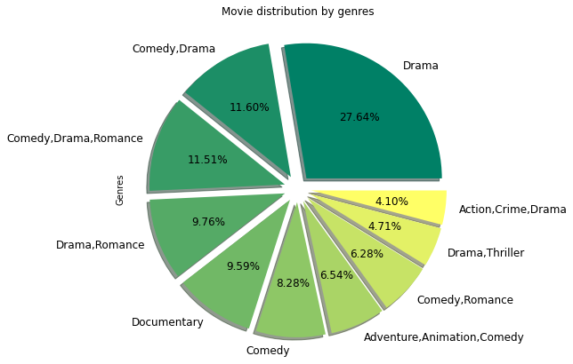
Movie distribution by genre

Slide 8
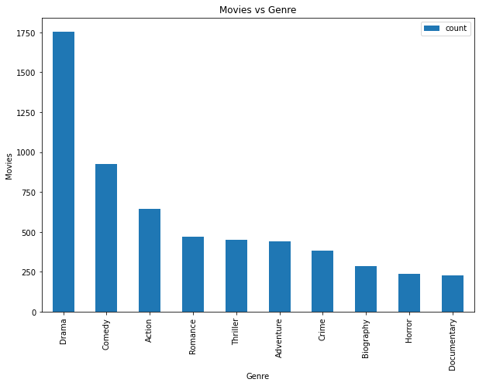
Best movies after the split
With an aim to get the genre that was rated the highest, we split the genres representing movies with multiple genres
This thus means each movie has one genre allocated to it

Slide 9
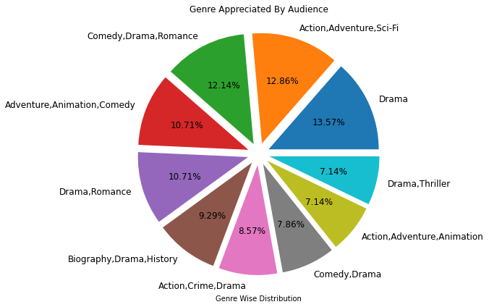
Distribution of Genres liked by audience

Slide 10
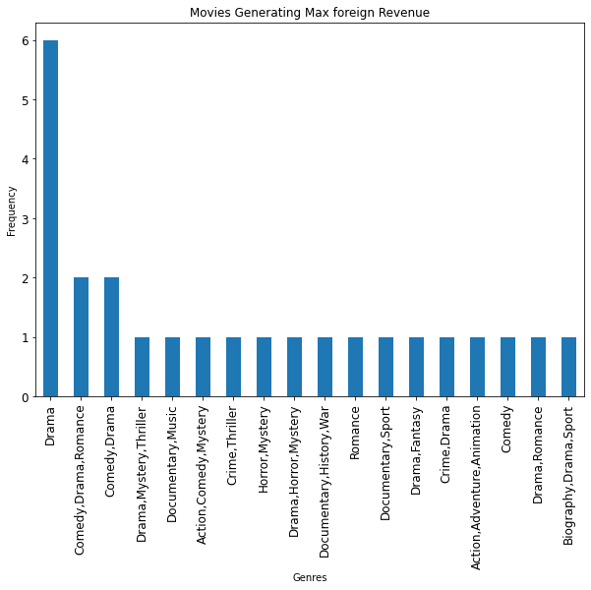
Foreign currency generated from different genres

Slide 11
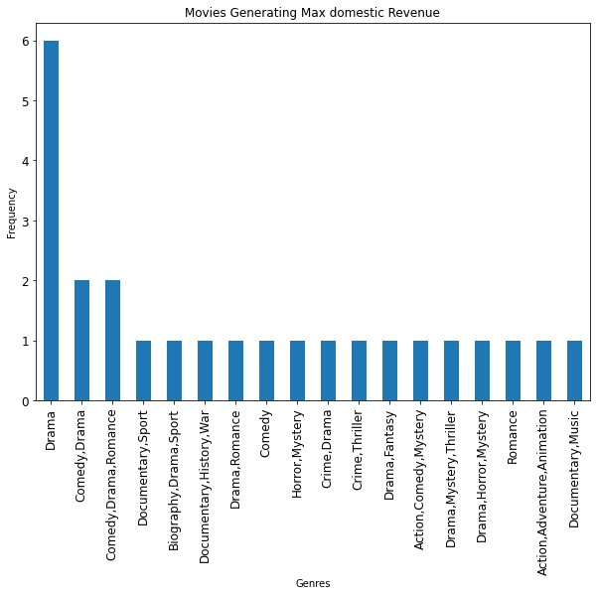
Domestic Revenue Generated from genres

Slide 12
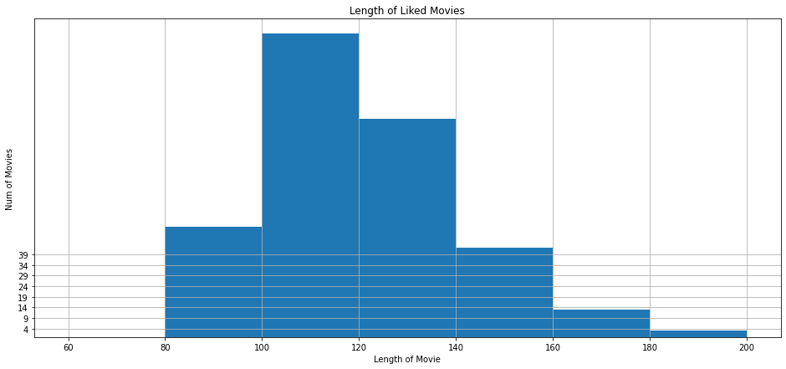
Movie length vs votes

Slide 13
Tools used
The following are the tools used in the analysis of this data was python
Pandas, numpy, matplotlib and seaborn were the libraries imported

Slide 14
Insights derived
This analysis leads to three recommendations for the success of Microsoft Movie Venture;
The team should ensure they venture into Drama Movies. These are more liked by viewers and generate the most income
From the analysis, it can be concluded that people enjoy movies that are around one and a half to two hours. This then means that they should focus on making movies that are within this length.
Most movies that already exist are Drama Movies. This thus means there will be a lot of competition. To make them more relevant in the movie industry, they should try incorporate comedy in their Drama movies, as comedy was rated the second best genre.

Slide 15
Limitations
The process of merging the data eliminated a lot of rows that would otherwise be useful in this anlysis

